Slide 1
Tutorial 1

Slide 2
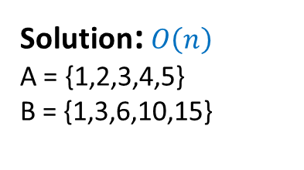
Tutorial 1- Analysis of Algorithms
public void example1 ( int A[], int B[] ) {
// store the prefix sums of A into B
int i,sum;
sum = 0;
for( i=0; i < A.length; i++ ) {
sum += A[i];
B[i] = sum;
}
}
Solution: $O\left(n\right)$
A = {1,2,3,4,5}
B = {1,3,6,10,15}

Slide 3
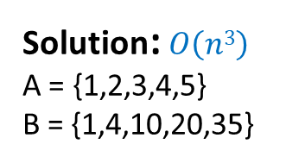
Tutorial 1- Analysis of Algorithms
public void example2 ( int A[], int B[] ) {
// store the prefix sums of prefix sums of A into B
int i,j,k,sum;
for( i=0; i < A.length; i++ ) {
sum = 0;
for( j=0; j <= i; j++ ) {
for( k=0; k <= j; k++ ) {
sum += A[k];
}
}
B[i] = sum;
}
}
Solution: $O\left(n3\right)$
A = {1,2,3,4,5}
B = {1,4,10,20,35}

Slide 4
Tutorial 1- Analysis of Algorithms
Suppose each row of an n x n array A consists of 1's and 0's such that, in any row of A, all the 1's come before any of the 0's in that row. Assuming A is already in memory, describe a method running in O(n) time (not O(n²) time) for finding the row of A that contains the most 1's.

Slide 5
Tutorial 1- Analysis of Algorithms
Start in the lower left corner of the array and follow this rule:
If there is a 1 to your right, store the row number and move right; otherwise, move up.
Keep going until you reach the top of the array. The answer will be the last row number stored.

Slide 6
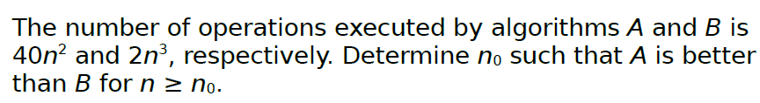

Tutorial 1- Analysis of Algorithms
Solution:
This is true so long as
$$40n2≤2n3 ,for n≥n0$$
Thus,
$$20≤n ,for n≥n0$$
so $n0≥20$.

